Slide 1
Android User Interface
Unit 3

Slide 2
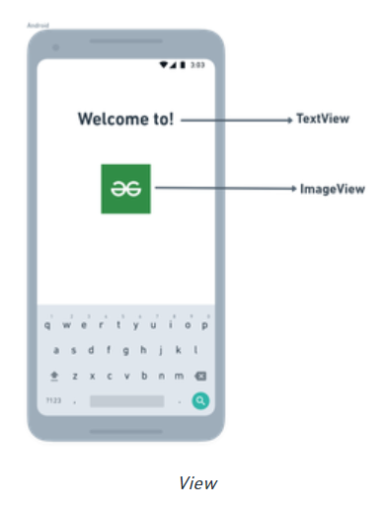
Components of the Screen
View
A View is defined as the user interface which is used to create interactive UI components such as TextView, ImageView, EditText, RadioButton, etc.
A view occupies a rectangular area on the screen and is responsible for drawing and event handling. They are generally called Widgets.
The basic building block for user interface is a View object which is created from the View class (android.view.View)

Slide 3
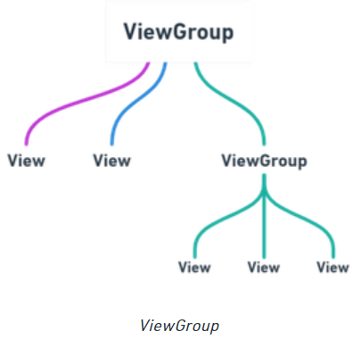
Components of the Screen
ViewGroup
A ViewGroup is special type of view that provides the layout for other views.
It is an invisible container that groups/holds other Views and other ViewGroups. It provides an order of appearance and sequence for the views.
E.g. RadioGroup and ScrollView.
A ViewGroup object is derived from the base class ViewGroup class (android.view.ViewGroup)

Slide 4
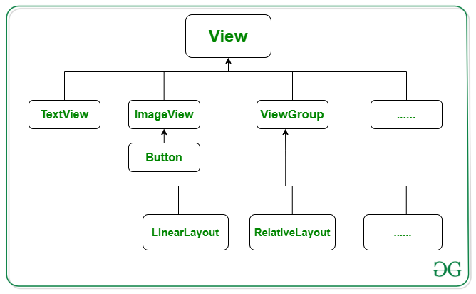
Components of the Screen
Layout
A Layout is derived from android.view.ViewGroup.
It is used as a container for other views.
The purpose of a ViewGroup is to group views logically—such as a group of buttons with a similar purpose. A Layout is used to group and arrange views visually on the screen.

Slide 5
Layouts in Android UI
Absolute Layout – AbsoluteLayout enables you to specify the exact location of its children.
Frame Layout – The FrameLayout is a placeholder on screen that you can use to display a single view.
Linear Layout – LinearLayout aligns all children in a single direction, vertically or horizontally.
Table Layout - TableLayout is a places the views into rows and columns.
Relative Layout - RelativeLayout displays child views in relative positions to their parent/sibling view.
Constraint Layout - assigns constraints for every child view/widget relative to other views present or the screen.
Scroll View – ScrollView enables users to scroll through a list of views that occupy more space than the physical display.

Slide 6
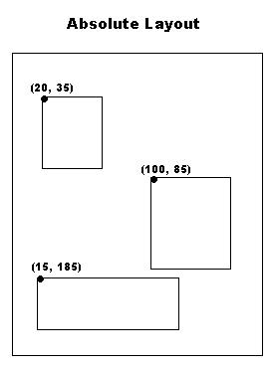
Absolute Layout
An Absolute Layout lets you specify exact locations (x/y coordinates) of its children.
Absolute layouts are less flexible and harder to maintain than other types of layouts without absolute positioning.

Slide 7
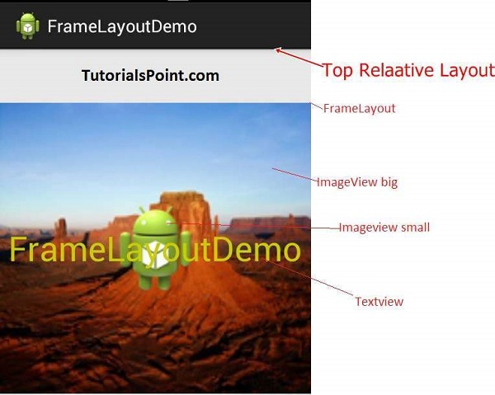
Frame Layout:
FrameLayouts are built to hold one view.
There is no hard rule that FrameLayouts can't be used to hold multiple views.
To control the positions of multiple views within the FrameLayout, we need to assign gravity to each child, using the android:layout_gravity attribute.
The FrameLayout is used to help you control the stacking of views as the screen is resized.

Slide 8
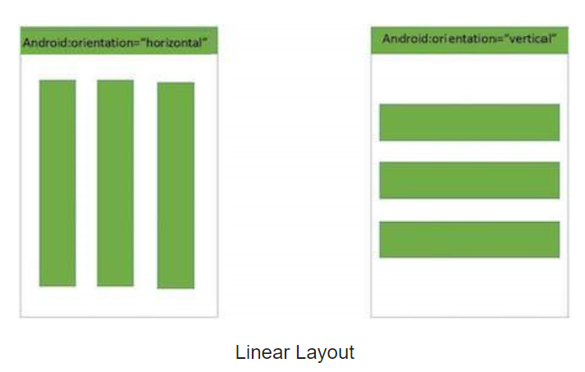
Linear Layout
LinearLayout aligns all children in either vertically or horizontally.
LinearLayout(Horizontal) and LinearLayout(Vertical) are actually the same layout with one property changed.
The android:orientation property of the LinearLayout controls if the application has a horizontal or vertical flow.
This specifies how an object should position its content, on both the X and Y axes. Possible values are top, bottom, left, right, center, center_vertical, center_horizontal etc.

Slide 9
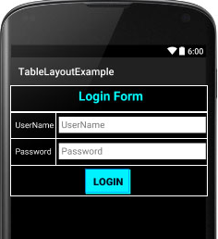
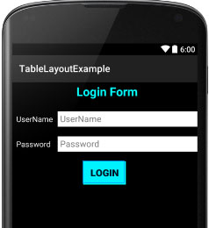
Table Layout
The TableLayout Layout groups views into rows and columns.
You use the <TableRow> element to designate a row in the table.
Each row can contain zero or more views.
Each view you place within a row forms a cell. A cell can hold only one view.
The width of each column is determined by the largest width of each cell in that column.
Table Layout Structure
Table Layout UI Output

Slide 10
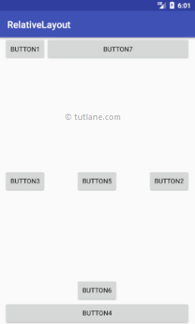
Relative Layout
The Relative Layout is very flexible layout used in android for custom layout designing.
The Relative Layout enables you to specify how child views are positioned relative to each other or relative to the container or another container.
It allows us to position the component anywhere we want using “above, below, left and right” to arrange the component’s position in relation to another component.
Example – layout_above, layout_below, layout_left, layout_right, layout_alignParentBottom, layout_alignParentTop, layout_alignParentLeft, layout_alignParentRight, etc.

Slide 11
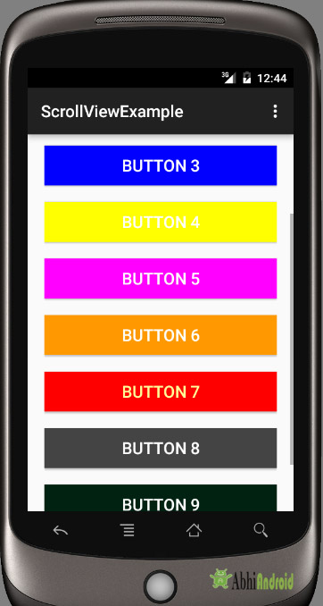
Scroll View
A ScrollView enables you to scroll your application from either top to bottom or bottom to top.
A ScrollView allows users to scroll through a list of views that occupy more space than the physical display.
A scroll view contains a single direct child only.
In order to place multiple views in the scroll view, one needs to make a view group(like LinearLayout) as a direct child and then we can define many views inside it.

Slide 12
Common Attributes used in Views and ViewGroups
Attribute | Description
layout_width | Specifies the width of the view or ViewGroup
layout_height | Specifies the height of the view or ViewGroup
layout_marginTop | Specifies extra space on the top side of the view or ViewGroup
layout_marginBottom | Specifies extra space on the bottom side of the view or ViewGroup
layout_marginLeft | Specifies extra space on the left side of the view or ViewGroup
layout_marginRight | Specifies extra space on the right side of the view or ViewGroup
layout_gravity | Specifies how child views are positioned
layout_weight | Specifies how much of the extra space in the layout should be ­allocated to the view
layout_x | Specifies the x-coordinate of the view or ViewGroup
layout_y | Specifies the y-coordinate of the view or ViewGroup

Slide 13
Units of Measurement
When specifying the size of an element on an Android UI, you should be aware of the following units of measurement:
dp—Density-independent pixel. 1 dp is equivalent to one pixel on a 160dpi(dot per inch/pixel per inch) screen. This is the recommended unit for specifying the dimension of views in your layout. The 160 dpi screen is the baseline density assumed by Android. You can specify either dp or dip when referring to a density-independent pixel.
sp—Scale-independent pixel. This is similar to dp and is recommended for specifying font sizes.
pt—Point. A point is defined to be 1/72 of an inch, based on the physical screen size.
px—Pixel. Corresponds to actual pixels on the screen. Using this unit is not recommended, as your UI might not render correctly on devices with a different screen resolution.

Slide 14
Adapting to Display Orientation
One of the key features of modern smartphones is their ability to switch screen orientation, and Android is no exception.
Android supports two screen orientations: portrait and landscape.
When you change the orientation of your Android device, your current activity is destroyed and then re-created.
By default, when you change the display orientation of your Android device, the current activity automatically redraws its content in the new orientation.
This is because the onCreate() method of the activity is fired whenever there is a change in display orientation.

Slide 15
Adapting to Display Orientation
Two techniques to handle changes in screen orientation:
Anchoring — The easiest way is to “anchor” your views to the four edges of the screen. When the screen orientation changes, the views can anchor neatly to the edges.
Resizing and repositioning — The ultimate technique is resizing each and every view according to the current screen orientation. This is achieved by creating separate layouts for each orientation.

Slide 16
Anchoring Views
Anchoring can be easily achieved by using Relative Layout. The following attributes can be found in the various views used in anchoring views.
layout_alignParentTop — Aligns the view to the top of the parent view
layout_alignParentBottom — Aligns the view to the bottom of the parent view
layout_centerVertical — Centers the view vertically within its parent view
layout_centerHorizontal — Centers the view horizontally within its parent view
layout_alignParentLeft — Aligns the view to the left of the parent view
layout_alignParentRight — Aligns the view to the right of the parent view
Anchoring can be easily achieved by using Constraint Layout in UI.

Slide 17
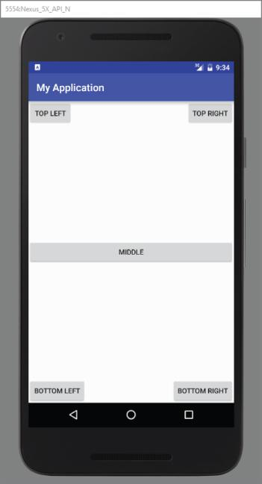
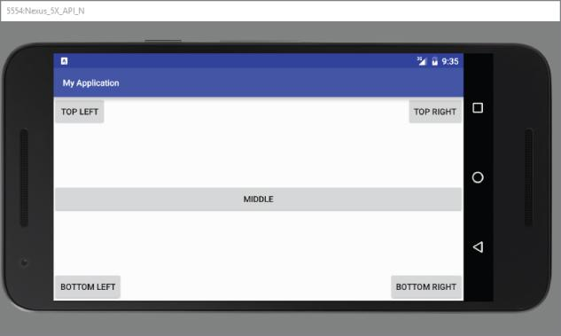
When the screen orientation changes to landscape mode, the four buttons are aligned to the four edges of the screen and the center button is centered in the middle of the screen with its width fully stretched.

Slide 18
Resizing and Repositioning
Apart from anchoring your views to the four edges of the screen, an easier way to customize the UI based on screen orientation is to create a separate res/layout folder containing the XML files for the UI of each orientation.
To support landscape mode, you can create a new folder in the res folder and name it as layout-land (representing landscape).
The main.xml file contained within the layout folder defines the UI for the activity in portrait mode, whereas the main.xml file in the layout-land folder defines the UI in landscape mode.

Slide 19
Managing Changes to Screen Orientation
An activity goes through the following stages during change in screen orientation -
When the device changes orientation, the activity is destroyed: i.e., the following methods are executed:
onPause()
onStop()
onDestroy()
It is then re-created: i.e., the following methods executed:
onCreate()
onStart()
onResume()
It is important to understand this behavior to preserve the state of your activity before it changes orientation.

Slide 20
Managing Changes to Screen Orientation
For example, your activity might have variables containing values needed for some calculations in the activity. For any activity, you should save the state in the onPause() method, which is fired every time the activity changes orientation.
Another important behavior to understand is that only views that are named (via the android:id attribute) in an activity have their state persisted when the activity they are contained in is destroyed.
For example, the user might change orientation while entering some text into an EditText view. When this happens, any text inside the EditText view is persisted and restored automatically when the activity is re-created.
Conversely, if you do not name the EditText view using the android:id attribute, the activity isn't able to persist the text currently contained within it.

Slide 21
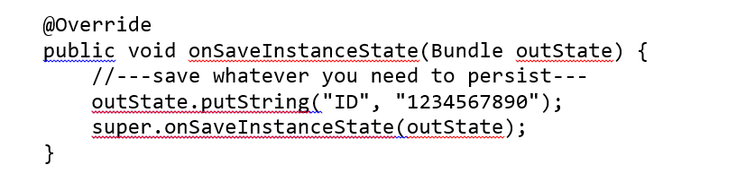
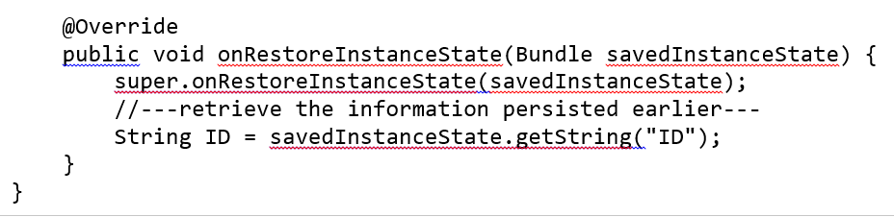
Persisting State Information During Changes in Screen Orientation
Changing screen orientation destroys an activity and re-creates it. As a result of this the current state of the activity might be lost.
When an activity is killed, it fires one or both of the following methods: onPause() and onSaveInstanceState(). These methods are fired whenever an activity is about to be killed or put into the background.
The onSaveInstanceState() method, provides a Bundle object as an argument so that you can use it to save your activity's state.
The onSaveInstanceState() method, provides a Bundle object as an argument so that you can use it to save your activity's state.

Slide 22
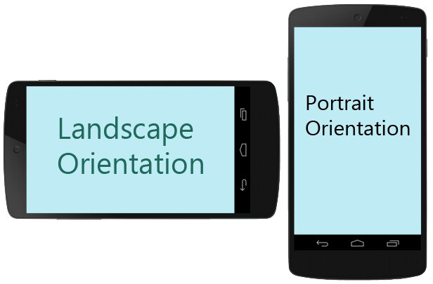
Detecting Orientation Changes
To determine the current screen orientation, you can use the following methods –
getResources().getConfiguration()
The above method contains an orientation object representing the screen of the device.
getResources().getConfiguration().orientation

Slide 23
Controlling the Orientation of the Activity
To ensure that your application is displayed in only a certain orientation use the setRequestedOrientation() method of the Activity class.
To set to Landscape mode, use the
setRequestedOrientation(ActivityInfo.SCREEN_ORIENTATION_LANDSCAPE);
To set to portrait mode, use the
setRequestedOrientation(ActivityInfo.SCREEN_ORIENTATION_PORTRAIT);
The methods constrains the activity to a certain orientation and prevents the activity from being destroyed, i.e., the activity will not be destroyed and the onCreate() method will not be fired again when the orientation of the device changes.
You can also specify the orientation value in the android:screenOrientation attribute in the XML layout file:
portrait—Portrait mode
sensor—Based on the accelerometer (default)

Slide 24
Interacting with UI
Users interact with your UI at two levels: the activity level and the view level.
At the activity level, the Activity class exposes methods that you can override. Some common methods that you can override in your activities include the following:
onKeyDown—Called when a key was pressed and not handled by any of the views contained within the activity
onKeyUp—Called when a key was released and not handled by any of the views contained within the activity
onMenuItemSelected—Called when a panel's menu item has been selected by the user.
onMenuOpened—Called when a panel's menu is opened by the user
At view level, each view is responsible for firing the methods specified in the Java file of that activity. E.g., onClick() method of a button which is called when the user clicks a button.

